Slide 1
DEPARTMENT OF MECHANICAL ENGINEERING
A PRESENTATION ON
Electric power generation using roller mechanism.
Presenting by :-
1) Atharva Rupesh Pachpute
2) Kamesh Jitendra Patil
3) Gaurav Ravindra Patil
4) Yahwant Devidas Salunke
College guide :-
Prof. M. N. Sonawane
Industry guide :-
Mr. Mayur Mankar

Slide 2
Content:-
Introduction
Literature review
Need of project
Problem Statement
Aim
Objectives
Methodology
Components
Working principle
Design
Advantages
Application

Slide 3
INTRODUCTION OF INDUSTRY
Name of Industry : Rishi Industries
Year of Establishment : 2010
Name of Owner : Mr. Praful & Mr. Vinay Chordia
Location : Ghoti BK, Tal. Igatpuri, Nasik.
Type of Industry : Food Processing Industry
Approximate Turnover : 3-4 Cr/Yr in Rupees.

Slide 4
Literature review:-
[1] Electric power generation using roller mechanism _ ( Santosh Sharma & Uday Kumar ) ___2014
In this project they studied on electric power generation using roller mechanism. By making roller mechanism. If we passed the vehicle from that roller mechanism rollers get rotated and hence electricity get generated.
[2] Power generation from speed breakers using multiple roller mechanism_ (Ardhendu Chakraborty,K Bharadwaj, Ms. Sandeepa) ___2016
In this project they have studied how to generate energy from speed breakers on road.

Slide 5
NEED OF PROJECT
To fix material handling problem in an industry.
Need in industry to move material from one point to another for food processing.
To Regenerate Electric Energy.

Slide 6
PROBLEM STATEMENT
To develop a material handling roller conveyor which can generate the electricity.
It will help to lighting system of industry and hence we can save the amount of electricity required for lighting system.

Slide 7
AIM
To design and manufacture Energy regenerating roller conveyor System for material handling purposes in food processing industry.
To generate own power for lighting system.
To achieve required material transfer rate for smooth operation.
To bring flexibility in manufacturing process.

Slide 8
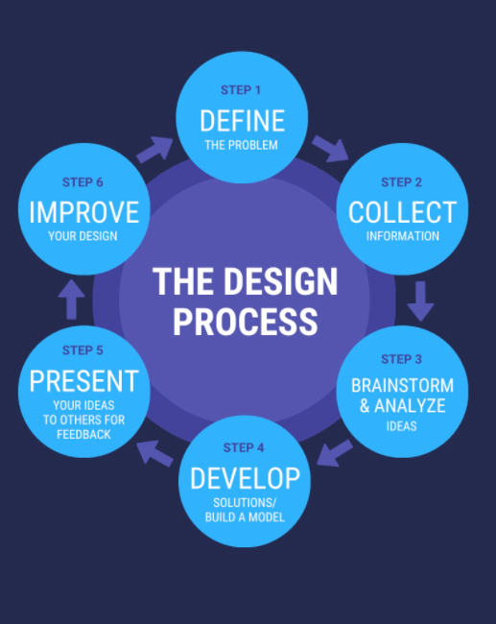
Methodology

Slide 9
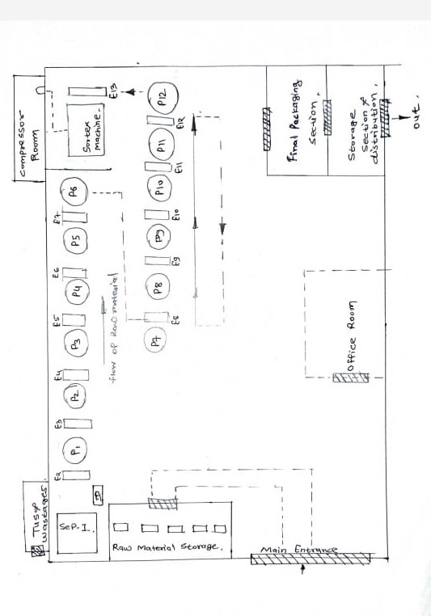
Plant Layout

Slide 10
BRIEF INTRODUCTION
Designing and manufacturing of material handling system in industry.
Roller conveyor is a type of vertical or inclined transport equipment that efficiently moves goods on floors.
Generally powered by electrical motors that either drive traction .
But here We are going to Regenerate energy from conveyor system.

Slide 11
COMPONENTS
Roller
Angle iron
Channel
Clips
Bearings
Nut bolts
Dynamo motor
Wiring

Slide 12
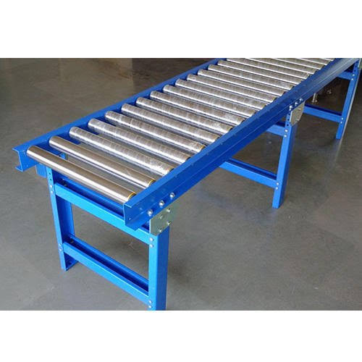
DIAGRAM

Slide 13
Working Principle
We are attaching motor to every roller. When we put any material on conveyor with help of gravity that conveyor will take material to destination which will tend to rotate the roller. As roller are connected to the motor will rotate and rotation of motor will produce electro magnetic induction and hence the electricity.

Slide 14
DESIGN SPECIFICATIONS
1) Roller: D1= 110 mm (3 nos)
D2= 73 mm (21 nos)
2)Total length :4 meter (13.5 ft)
3) Spacing : 190.5 mm
4) Motor : 12 volt

Slide 15
ADVANTAGES
No power material handling system
Power is generated while working
Developed power can be used to lighting system
Flexible material handling system.

Slide 16
LIMITATIONS
Bearing failure may occur due to unbalancing.
Height adujtment required for reverse flow.

Slide 17
APPLICATIONS
Food industries
Mechanical industries
Tunnel making
Aerospace applications- for unloading materials.

Slide 18
THANK YOU…!

